Slide 1
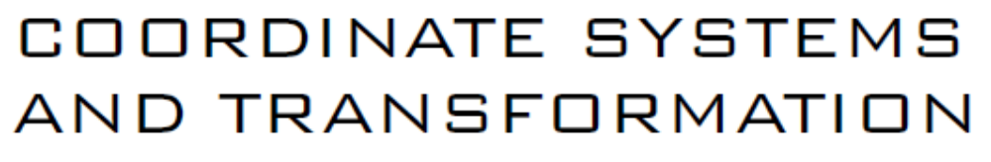
UNIT-I

Slide 2
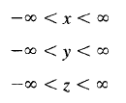
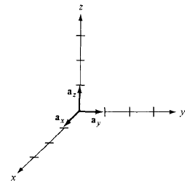
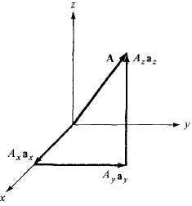
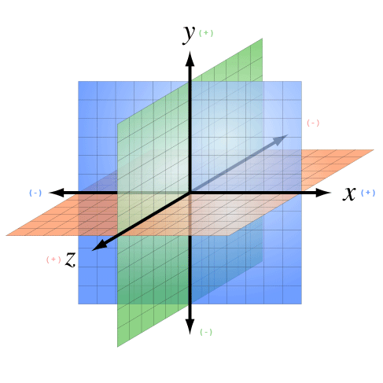
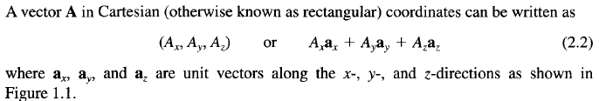
1. Cartesian Coordinate System
A point P is represented by (x,y,z)
The ranges of coordinate variable x,y,z are:
YZ-Plane
XY-Plane
ZX-Plane

Slide 3
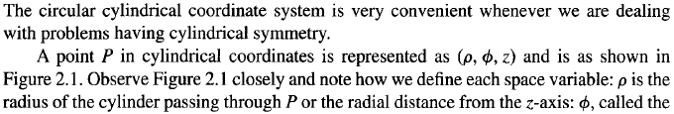
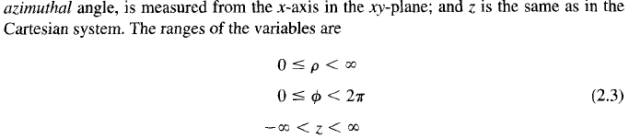
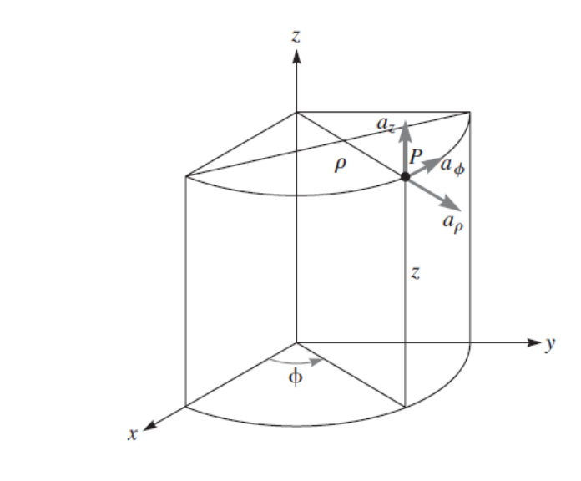

2. Circular Cylindrical Coordinate Systems and Transformation

Slide 4
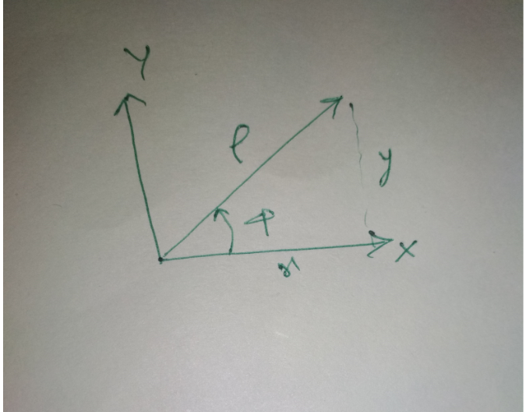

Slide 5
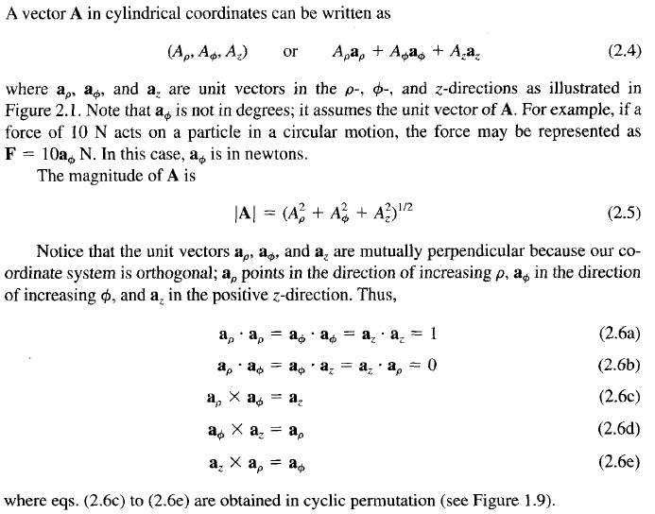
2. Circular Cylindrical Coordinate Systems and Transformation

Slide 7
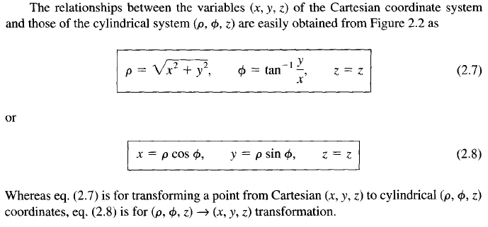
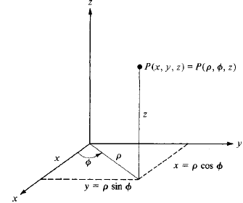

2. Circular Cylindrical Coordinate Systems and Transformation

Slide 8
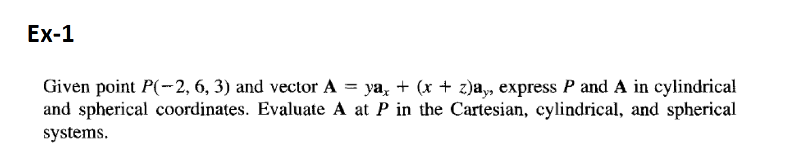

Slide 9
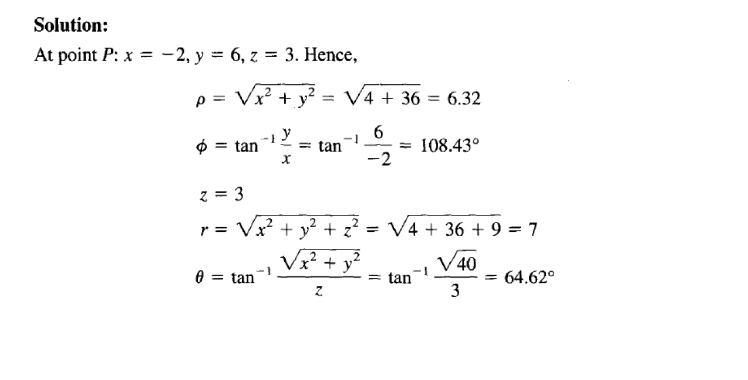

Slide 11
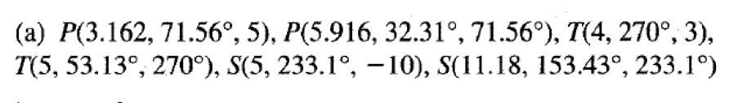

Slide 12
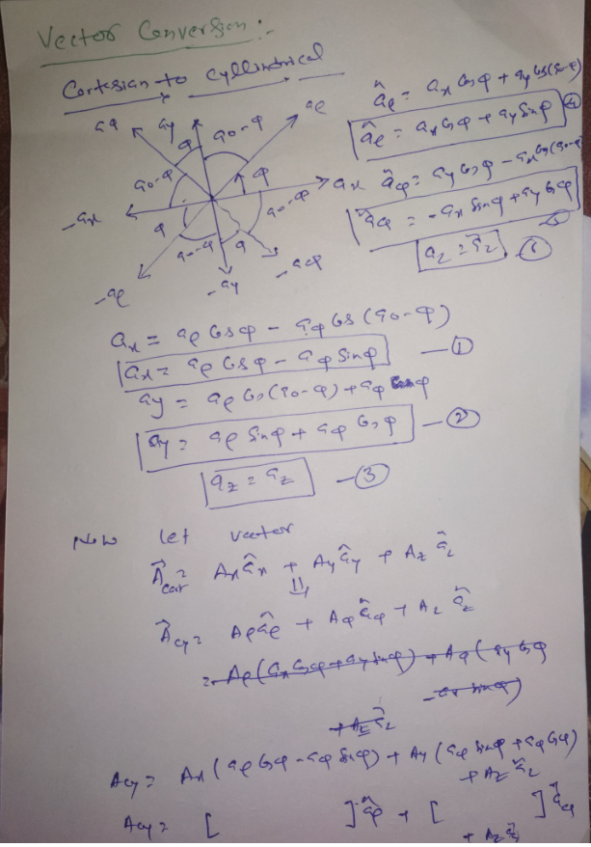


Slide 13
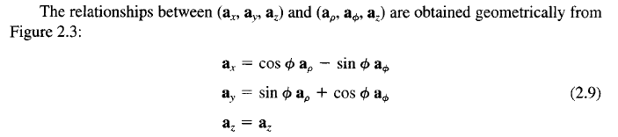


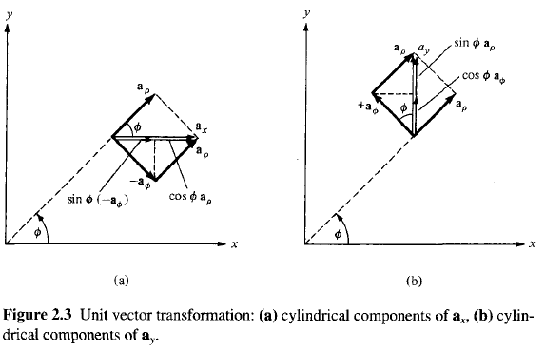
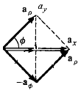
2. Circular Cylindrical Coordinate Systems and Transformation
(d)
(c)

Slide 14
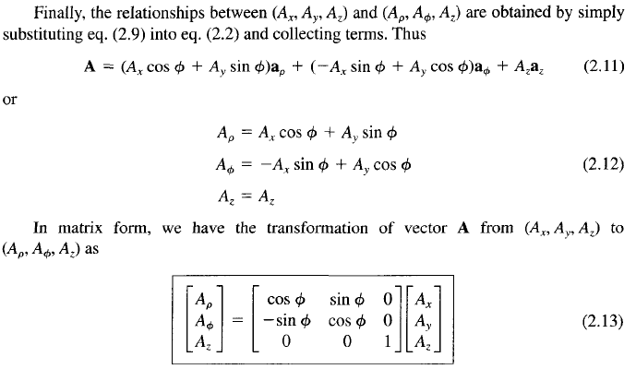
2. Circular Cylindrical Coordinate Systems and Transformation

Slide 15
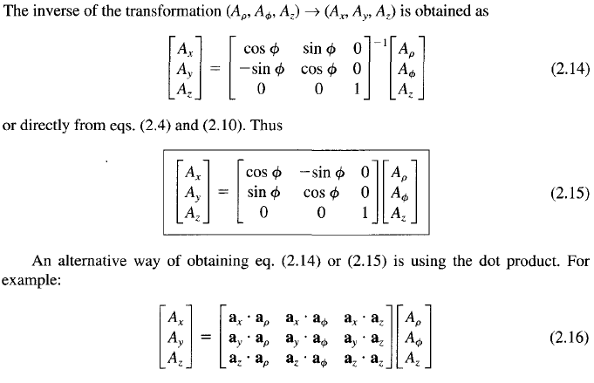
2. Circular Cylindrical Coordinate Systems and Transformation

Slide 16


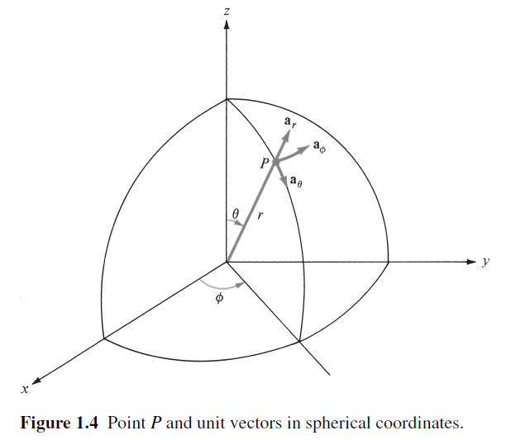

3. Spherical Coordinate System and Transformation
*Colatitude: the complement, in spherical coordinates, of a latitude (the difference between a latitude and 90 degrees)

Slide 17
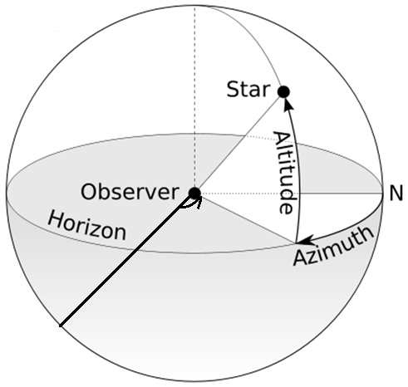
The Azimuth
An azimuth (from Arabic al-sumūt, meaning "the directions") is an angular measurement in a spherical coordinate system.
The vector from an observer (origin) to a point of interest is projected perpendicularly onto a reference plane; the angle between the projected vector and a reference vector on the reference plane is called the azimuth.

Slide 18
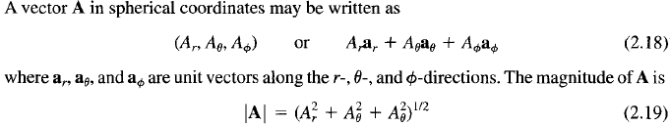
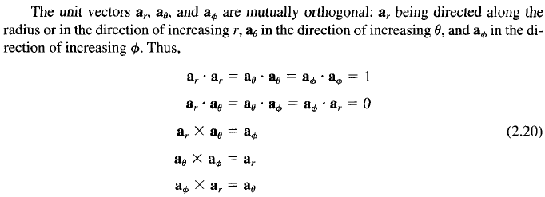
3. Spherical Coordinate System and Transformation

Slide 19
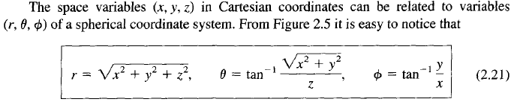
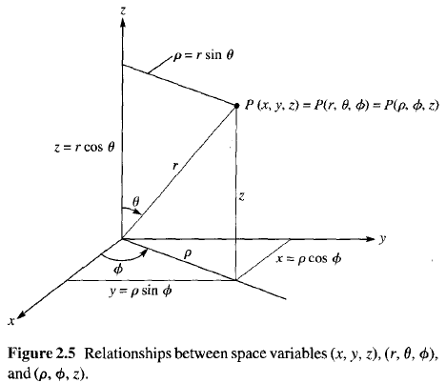
3. Spherical Coordinate System and Transformation

Slide 20
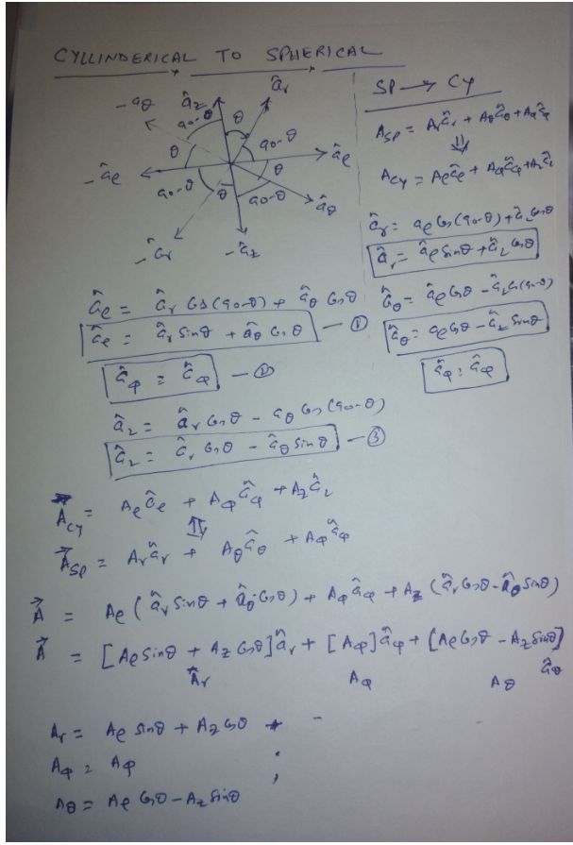

Slide 21
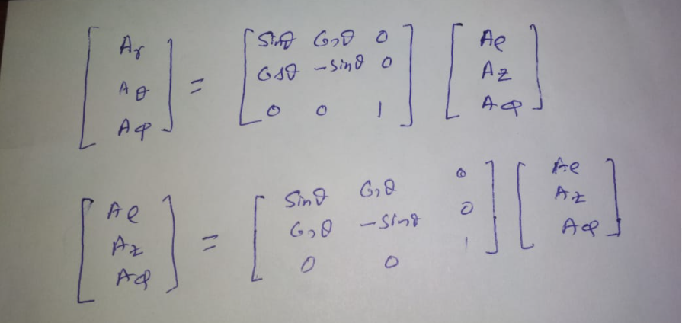
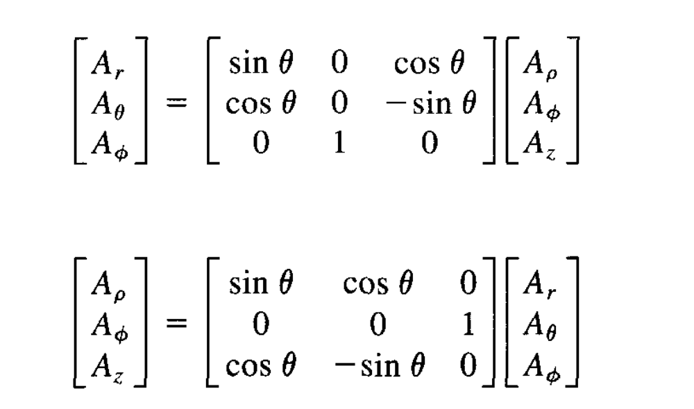

Slide 22
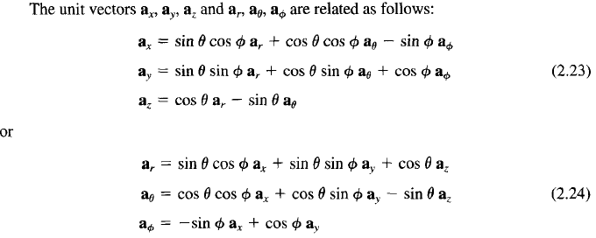


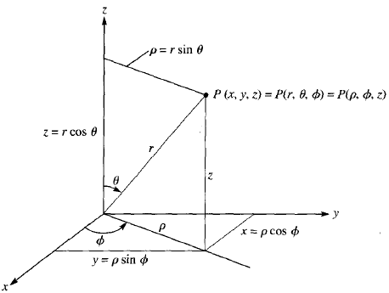
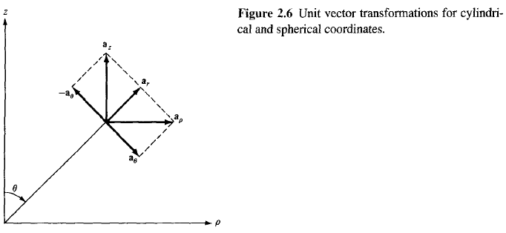
3. Spherical Coordinate System and Transformation

Slide 23
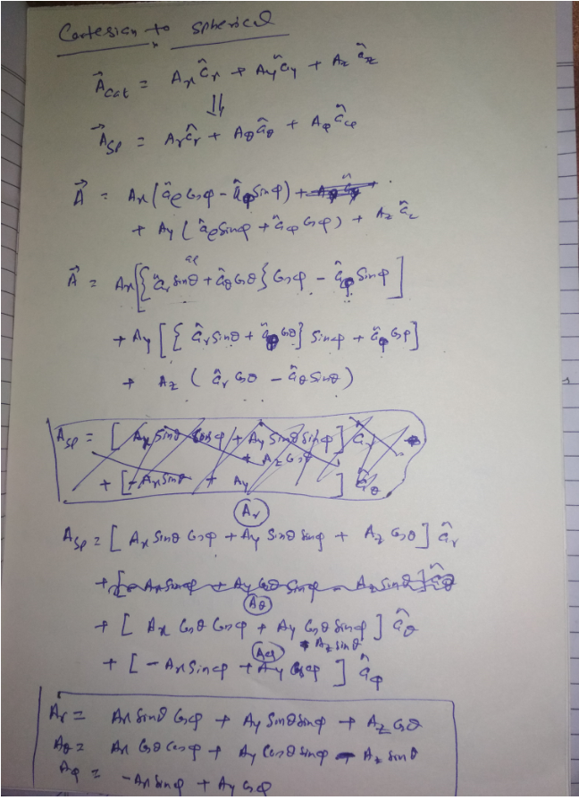

Slide 24
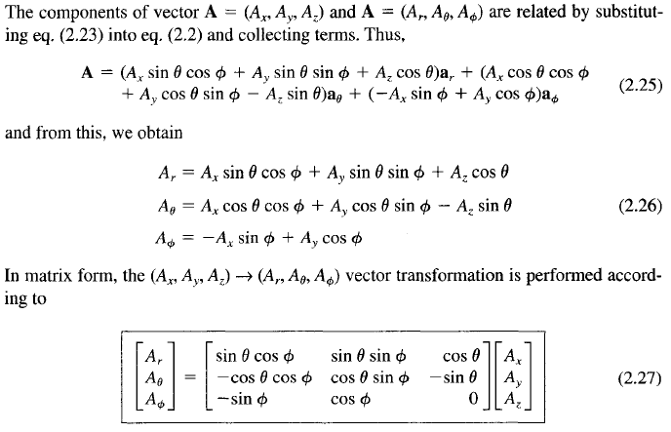
3. Spherical Coordinate System and Transformation

Slide 25
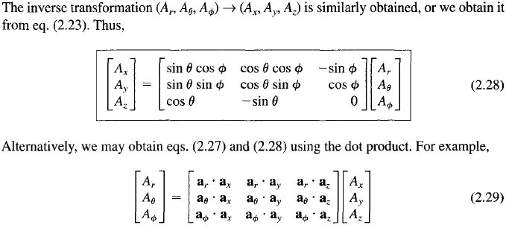
3. Spherical Coordinate System and Transformation

Slide 26
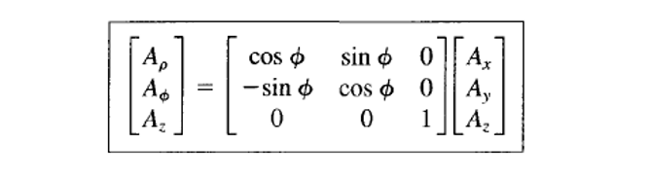

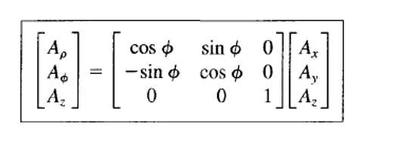
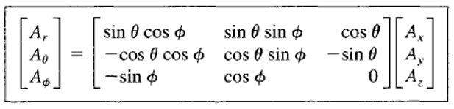

Slide 27
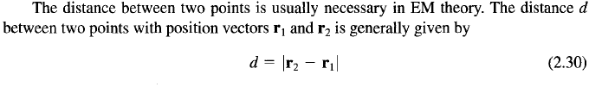
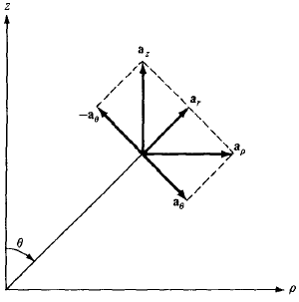
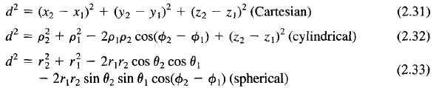

Distance Between Two Points

Slide 28
Thanks !

